Slide 1

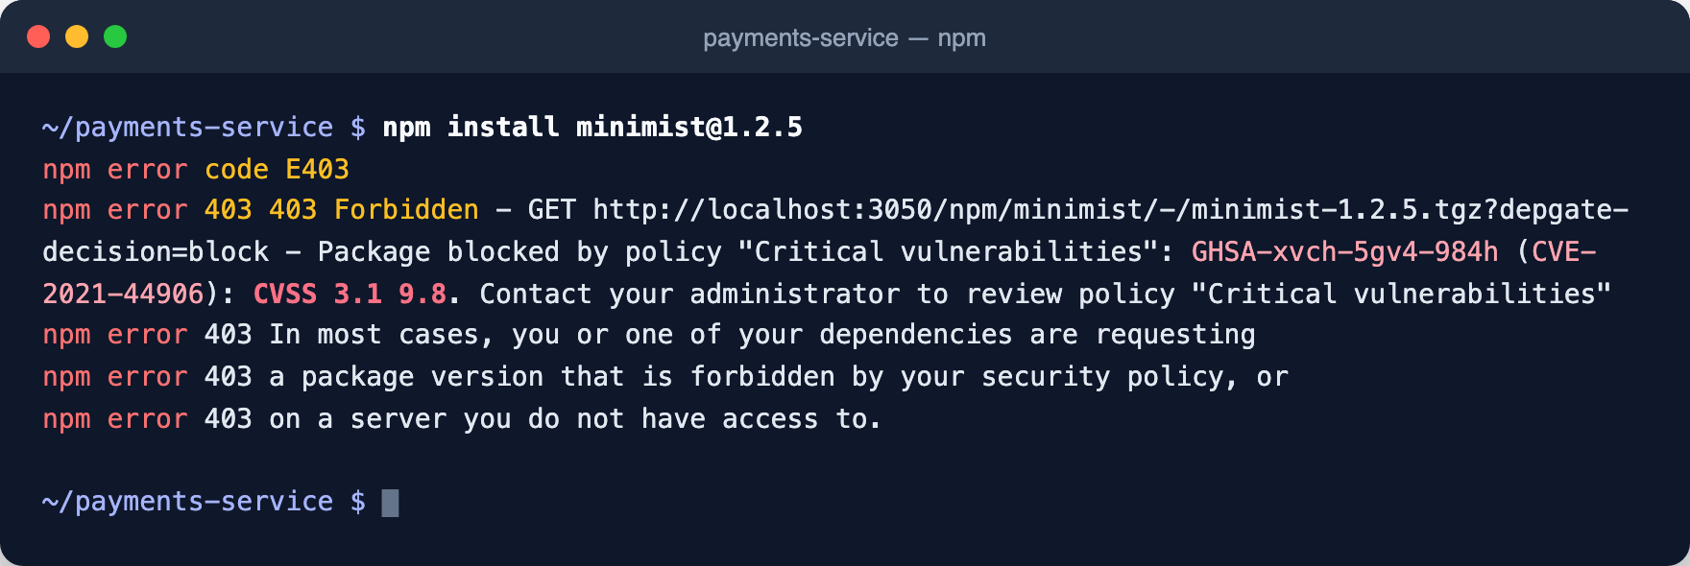
Why a gateway, not a scanner
DEPGATE DEEP DIVE
DepGate is an open-source proxy and policy engine in front of npm, PyPI, Maven, Go, NuGet, Cargo, Composer and RubyGems. Scanning after install is too late: install scripts have already run.
Block
Roll out
Malware protection
Policy-based blocking
Namespace protection
Monitor mode
Exceptions and waivers
Package check
Audit
Integrate
Decision Ledger
Audit Log
Log streaming, webhooks
SSO (OIDC and SAML)
CI tokens, REST API
8 package ecosystems
A real install: npm prints the policy and the CVE that blocked it.
Notes:
DepGate sits between package managers and the registries. Developers and CI point npm, pip, mvn and the rest at DepGate instead of the public registry. The core argument: a hijacked maintainer account or a typosquatted name can reach thousands of builds within hours, and a scanner that runs after install is too late because install scripts have already executed. The screenshot is a real install: the starter policy “Critical vulnerabilities” blocks minimist 1.2.5 and npm prints the CVE and CVSS score. The malware check runs before any policy.

Slide 2
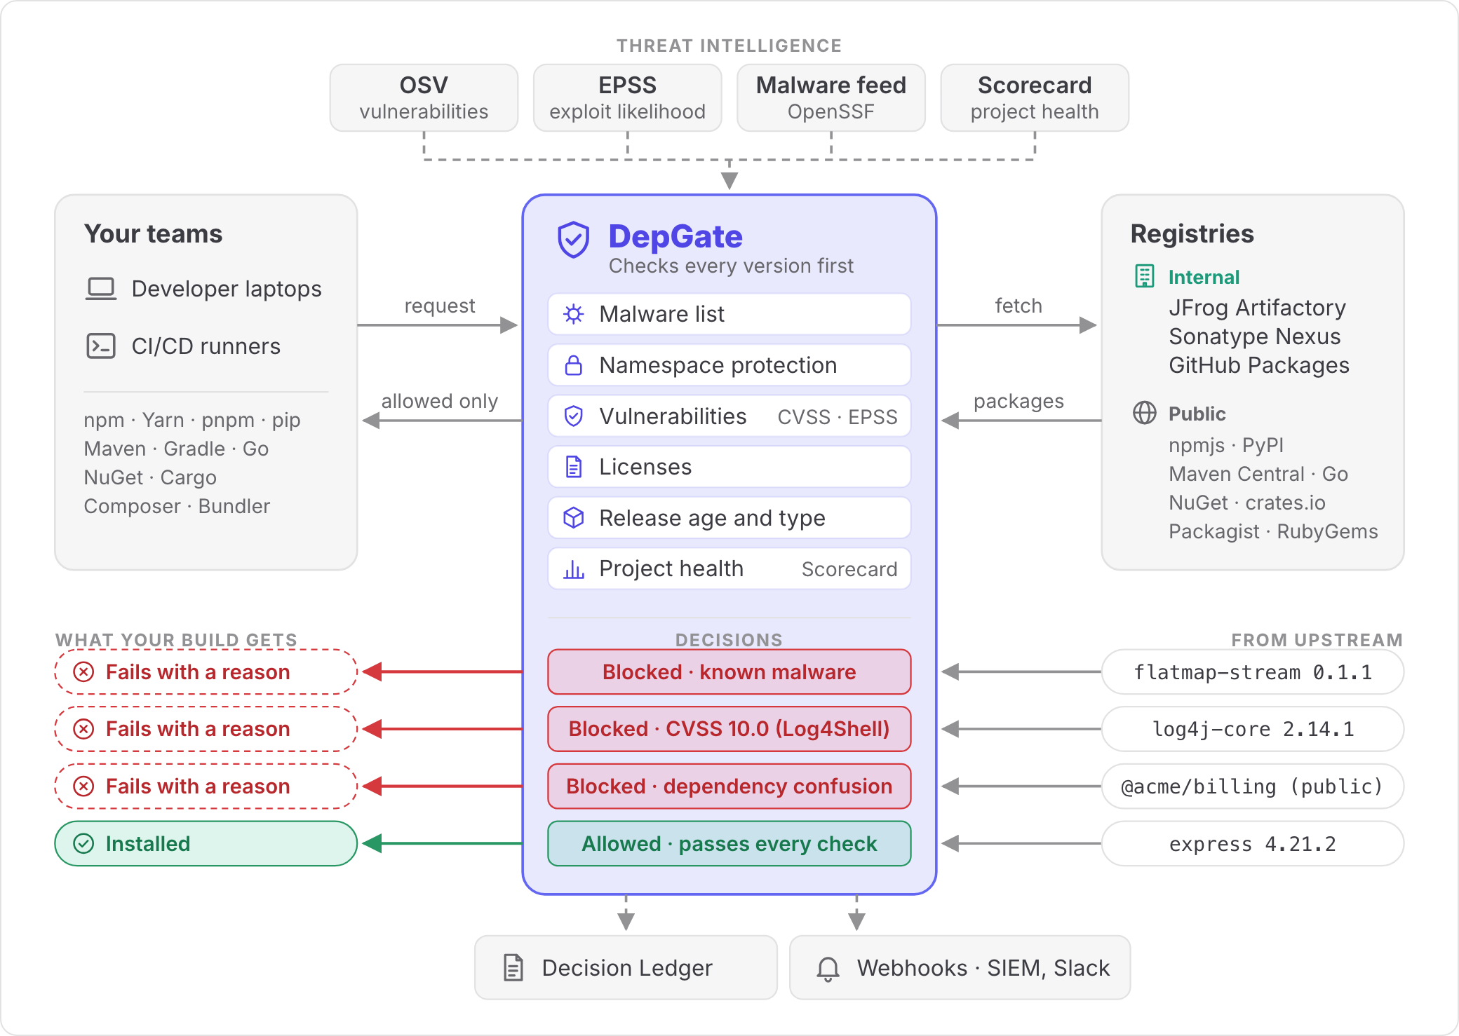
Where DepGate sits
ARCHITECTURE
Teams keep their tools
Laptops and CI runners point npm, pip, Maven and the rest at DepGate.
Every version is checked first
Malware, namespace, vulnerabilities, licenses, release age and project health.
Threat data refreshed daily
OSV, EPSS, the OpenSSF malware feed and OpenSSF Scorecard.
Every block is recorded
In the Decision Ledger, and streamed to a SIEM or chat.
Notes:
Read the diagram left to right. Your teams keep their usual tools and point them at DepGate instead of the public registry. DepGate fetches metadata and files from the registries you connect: public ones such as npmjs and Maven Central, and internal ones such as Artifactory, Nexus or GitHub Packages. Every version is checked against the malware list, namespace protection and your policies, kept current with daily threat intelligence. The bottom rows are real examples: flatmap-stream 0.1.1 (the 2018 event-stream payload) is blocked as known malware, log4j-core 2.14.1 is blocked at CVSS 10.0, a public @acme/billing look-alike is blocked as dependency confusion, and express 4.21.2 passes and installs. Inside the gateway the first check that decides wins: namespace protection, then exceptions, the malware list, then policies by priority. New policies can run in monitor mode first, recording what they would block without blocking.

Slide 3
Deployment scenarios
ARCHITECTURE
1. Gateway to the public registries
The usual starting point. Teams without an artifact repository point clients at DepGate.
Developers, CI
→
DepGate
→
Public registries
2A. In front of Artifactory or Nexus
Recommended. Every request is checked, new policies apply at once, and the ledger names the person or pipeline.
Developers, CI
→
DepGate
→
Artifactory or Nexus
→
Public
2B. Behind Artifactory or Nexus
No client changes. But cached versions bypass later decisions, and the ledger sees only the repository’s account.
Developers, CI
→
Artifactory or Nexus
→
DepGate
→
Public
Notes:
Three topologies. 1: the simplest setup. DepGate proxies the public registries directly and everyone connects their package manager to it; the usual first step. 2: many organizations already run Artifactory or Nexus. DepGate does not replace it: the repository keeps caching and hosting, DepGate adds the security decisions. 2A, DepGate in front (recommended): clients point at DepGate, which fetches through the repository. Every request is checked, policy changes and newly disclosed vulnerabilities apply at once, and the Decision Ledger shows which person or pipeline was refused. 2B, the repository in front: its remote repositories point at DepGate, so developer machines need no change. The limits: Artifactory and Nexus serve cached files without asking DepGate again, so a version cached before a policy or a disclosure keeps being served until it is removed from the cache; the ledger records blocks against the repository’s account; and Package check, waivers and monitoring only see cache misses. Its registry token lasts up to 365 days and must be renewed. The same topologies also support three further setups from the docs: internal and public packages behind one URL with namespace protection, per-job CI tokens that last one day, and air-gapped networks using internal mirrors.

Slide 4
How it compares and deploys
WHERE IT STANDS
Capability | DepGate | Sonatype | JFrog | Socket
Open source, self-hosted | Yes, MIT | Partial | Partial | Partial
Blocks at download time | Yes | Yes | Yes | Partial
Ecosystems | 8 | 17+ | All formats | A few
CVSS, EPSS, license and age rules | Yes | Yes | Yes | Partial
Monitor mode with impact report | Yes | Partial | Yes | Partial
Dependency-confusion protection | Yes | Yes | Partial | Partial
Heuristic malware detection | Roadmap | Yes | Partial | Yes
One image to run
A single container with PostgreSQL and Redis. Stateless replicas; runs air-gapped.
Fits beside Artifactory or Nexus
In front of them (recommended) or behind them as their upstream.
Known gaps
Fewer ecosystems, and never-seen malware is not yet detected.
Sonatype = Nexus Repository + Firewall; JFrog = Artifactory + Curation / Xray. Partial = partial or paid tier. Public documentation, October 2026.
Notes:
The positioning: an open-source answer to the commercial “repository firewall” products, with fewer moving parts. Partial for the commercial products mostly means the base repository is open source while the firewall, curation or scanning layer is paid; Socket’s free CLI wraps the package manager on each machine rather than gating centrally. Be direct about the gaps: 8 ecosystems versus 17+ for Sonatype, and heuristic detection of never-seen malware is on the roadmap, so today DepGate relies on the synced known-malware feed plus release-age cool-downs. Deployment: one container, PostgreSQL and Redis, stateless replicas behind a load balancer. With Artifactory or Nexus in front instead, cached versions bypass later policy decisions and the ledger only sees the repository’s account, which is why DepGate-in-front is the recommended option.

